Slide 1
Cloud Governance & Compliance
Syed Safdar Hussain
(Cloud Solutions Architect)
02-March-2023

Slide 2
Agenda
CAF & Why Governance
Defining Your Initial Governance State
Governance Methodology Overview
Take Action
Governance as Actionable Model
Veraqor Offers

Slide 3
Microsoft Cloud Adoption Framework for Azure
Best practices
Templates
People
Process
Technology
Achieve balance
Documentation
Tools
Control & Stability
Speed & Results
Align business, people and technology strategy.
Achieve business goals with actionable, efficient, and comprehensive guidance.
Deliver fast results with control and stability.

Slide 4
Why is Governance Important?
Who is responsible for monitoring? support? And operations?
Which services should be migrated to Azure?
Transformation
Risk mitigation
What roles & responsibilities must be defined?
What security measures should I consider?
What are the core processes needed for service management?
How do I ensure a balance between innovation, cost and agility?
Maintaining full compliance
Creating better cost visibility and control
Improving security posture
Being agile—to support scale
What organizational changes are needed?
What key capabilities I must develop?
Azure governance building blocks?

Slide 5
Governance Methodology Overview

Slide 6
Drive cloud adoption efficiency in an iterative governance process – four key exercises to focus on:
Methodology overview
Establish a basic understanding of cloud governance
Methodology overview
Establish a basic understanding of cloud governance
1
1
Governance benchmark
Assess your current state and the future state to get started
2
Initial governance foundation
Begin establishing your governance foundation by implementing a set of governance tools
3
Evolve governance foundation Iteratively add governance controls to address risks
4

Slide 7
Governance Methodology
Envision an end state – and incrementally build trust and confidence.
Govern
Define corporate policy
Business risks
Document evolving business risks and the business’ tolerance for risk, based on data classification and application criticality
Policy & compliance
Convert risk decisions into policy statements to establish cloud adoption boundaries
Process
Establish processes to monitor violations and adherence to corporate policies.
Five disciplines of cloud governance
Cost management
Evaluate & monitor costs, limit IT spend, scale to meet need, create cost accountability
Security baseline
Ensure compliance with IT security requirements by applying a security baseline to all adoption efforts
Resource consistency
Ensure consistency in resource configuration. Enforce practices for on-boarding, recovery, and discoverability
Identity baseline
Ensure the baseline for identity and access are enforced by consistently applying role definitions and assignments
Deployment acceleration
Accelerate deployment through centralization, consistency, and standardization across deployment templates
Governance funnels corporate policy changes into five actionable disciplines –
enabling your organization to modernize and reach business goals.
https://aka.ms/adopt/Gov

Slide 8
Governance – develops and evolves corporate policies for:
Resource consistency and management
Security baseline
Identity baseline
Cost management
Deployment acceleration
Cloud governance team
A team consisting of cloud architects, legal, security and/or HR & Finance develops and enforces these disciplines across your organization to ensure governance consistency.

Slide 9
Governance as Actionable Model

Slide 10
Govern Methodology Disciplines
Cost Management
Govern
Define corporate policy
Business risks
Document evolving business risks and the business’ tolerance for risk, based on data classification and application criticality
Policy and compliance
Convert risk decisions into policy statements to establish cloud adoption boundaries
Process
Establish processes to monitor violations and adherence to corporate policies.
Five disciplines of cloud governance
Cost management
Evaluate and monitor costs, limit IT spend, scale to meet need, create cost accountability
Security baseline
Ensure compliance with IT security requirements by applying a security baseline to all adoption efforts
Resource consistency
Ensure consistency in resource configuration. Enforce practices for on-boarding, recovery, and discoverability
Identity baseline
Ensure the baseline for identity and access are enforced by consistently applying role definitions and assignments
Deployment acceleration
Accelerate deployment through centralization, consistency, and standardization across deployment templates

Slide 11
Cost Management
Establish controls and processes to ensure proper allocation of cost across business units, implement cost guardrails, and analyze the cost of applications.
Azure tools and services
Define
Enterprise Enrollment Hierarchy Process and RACI Azure Cost Management Budgets and Alerts + RACI
Cost Management RBAC Model
Define Cost Management Policies
Tagging
Allowed VM SKUs
Allowed Storage SKUs
Allowed Networking SKUs
Allowed Database SKUs
Azure Policy
Azure Cost Management PBI Application in Azure Marketplace
Azure Advisor
Azure Portal
Azure EA Content Pack

Slide 12
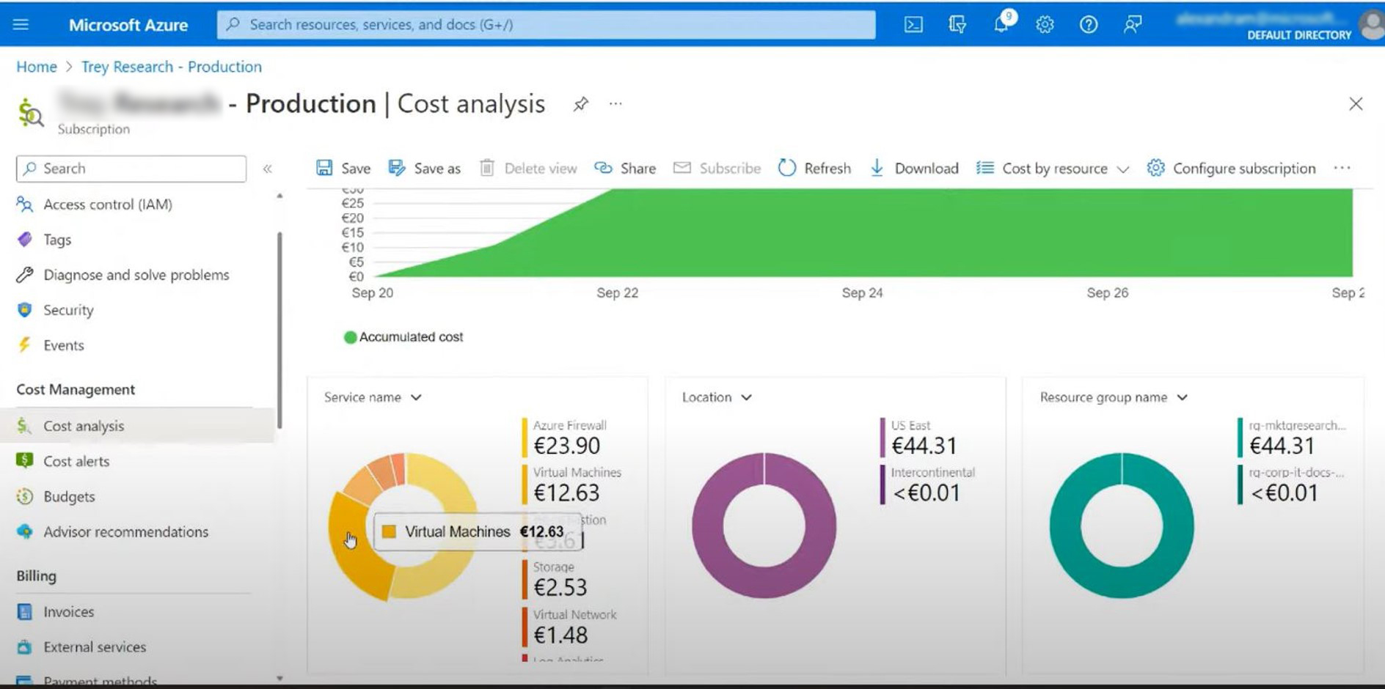

Slide 13
Govern Methodology Disciplines
Security Baseline
Govern
Define corporate policy
Business risks
Document evolving business risks and the business’ tolerance for risk, based on data classification and application criticality
Policy and compliance
Convert risk decisions into policy statements to establish cloud adoption boundaries
Process
Establish processes to monitor violations and adherence to corporate policies.
Five disciplines of cloud governance
Cost management
Evaluate and monitor costs, limit IT spend, scale to meet need, create cost accountability
Security baseline
Ensure compliance with IT security requirements by applying a security baseline to all adoption efforts
Resource consistency
Ensure consistency in resource configuration. Enforce practices for on-boarding, recovery, and discoverability
Identity baseline
Ensure the baseline for identity and access are enforced by consistently applying role definitions and assignments
Deployment acceleration
Accelerate deployment through centralization, consistency, and standardization across deployment templates

Slide 14
Security Baseline
Establish policies to protect your network, assets, and data –
residing on cloud provider platform(s).
Azure tools and services
Document risks, business tolerance, and mitigation strategies related to the security of:
Data and assets: develop clear, simple, and well-communicated guidelines to identify, protect, and monitor the most important data assets
Network: control and monitor any allowed communication between on-premises environment and cloud workloads.
Implement these best practices for corporate policy:
Network requirements: on-premises networks must be secured against potential unauthorized access from cloud-based resources.
Hybrid identity strategies: a key factor in structuring cloud-based identity services is the level of integration required with existing on-premises identity infrastructure.
Encryption: encryption mechanisms vary in cost and complexity, and both technical and policy requirements and can influence decisions on how encryption is applied and how to store and manage critical secrets and keys
Security Baseline policies: processes that manage updates to security policy based on inputs from stakeholders. (e.g., initial risk assessment and planning, deployment planning and testing, and quarterly review and planning)
Azure Policy
Azure Security Center
Azure Sentinel
Subscription Design
Encryption
Hybrid Identity
Azure Networking
Azure Automation

Slide 15
Sample Policies: Security Baseline
All deployed assets must be categorized by criticality and data classification.
All protected data must be encrypted when at rest.
Network subnets containing protected data must be isolated from any other subnets. Network traffic between protected data subnets is to be audited regularly.
All connections between the on-premises and cloud networks must take place either through a secure encrypted VPN connection or a dedicated private WAN link.
No public facing web site backed by IaaS should be exposed to the internet without DDoS.
Governance tooling must audit and enforce network configuration requirements defined by the Security Baseline team.
Trends and potential exploits that could affect cloud deployments should be reviewed regularly by the security team to provide updates to Security Baseline tooling used in the cloud..

Slide 16
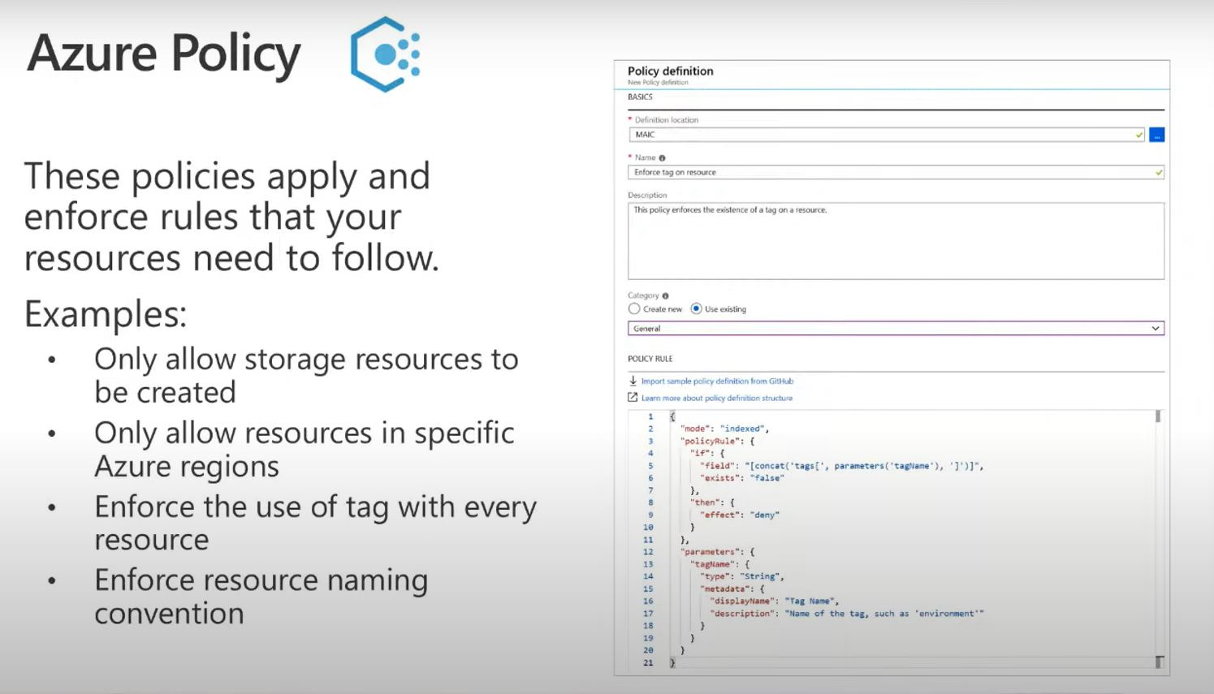

Slide 17
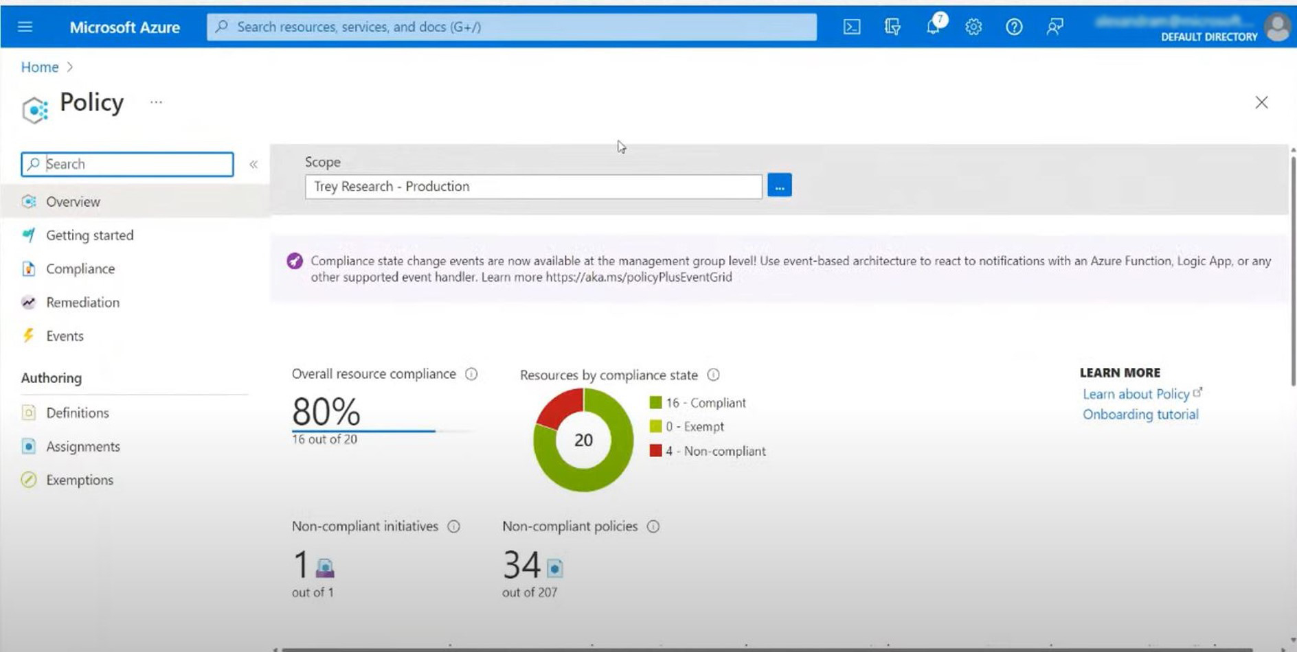

Slide 18
Govern Methodology Disciplines
Resource Consistency
Govern
Define corporate policy
Business risks
Document evolving business risks and the business’ tolerance for risk, based on data classification and application criticality
Policy and compliance
Convert risk decisions into policy statements to establish cloud adoption boundaries
Process
Establish processes to monitor violations and adherence to corporate policies.
Five disciplines of cloud governance
Cost management
Evaluate and monitor costs, limit IT spend, scale to meet need, create cost accountability
Security baseline
Ensure compliance with IT security requirements by applying a security baseline to all adoption efforts
Resource consistency
Ensure consistency in resource configuration. Enforce practices for on-boarding, recovery, and discoverability
Identity baseline
Ensure the baseline for identity and access are enforced by consistently applying role definitions and assignments
Deployment acceleration
Accelerate deployment through centralization, consistency, and standardization across deployment templates

Slide 19
Resource Consistency
Implement the foundation for governance best practices –
with correct resource organization.
Azure tools and services
Define Azure Management Groups & Subscriptions model and RACI
To reflect security, operations and business/accounting hierarchies
To group similar resources into logical collections
Define resource consistency roles & responsibilities
To further group applications or workloads into deployment and operations units
Define Resource Consistency Policies
Naming Conventions
Tagging
Allowed Locations
Allowed Resource Types
Allowed Extensions
Auditing
Azure Policy
Azure Monitor
Azure Advisor
Resource Manager Templates
Resource Graph
Management Groups

Slide 23
Govern Methodology Disciplines
Identity Baseline
Govern
Define corporate policy
Business risks
Document evolving business risks and the business’ tolerance for risk, based on data classification and application criticality
Policy and compliance
Convert risk decisions into policy statements to establish cloud adoption boundaries
Process
Establish processes to monitor violations and adherence to corporate policies.
Five disciplines of cloud governance
Cost management
Evaluate and monitor costs, limit IT spend, scale to meet need, create cost accountability
Security baseline
Ensure compliance with IT security requirements by applying a security baseline to all adoption efforts
Resource consistency
Ensure consistency in resource configuration. Enforce practices for on-boarding, recovery, and discoverability
Identity baseline
Ensure the baseline for identity and access are enforced by consistently applying role definitions and assignments
Deployment acceleration
Accelerate deployment through centralization, consistency, and standardization across deployment templates

Slide 24
Identity Baseline
Protect your data and assets in the cloud –
implementing identity management and access control.
Azure tools and services
Define Azure RBAC Model
Using RBAC can segregate duties within a team and grant only the amount of access to users that they need to perform their jobs. Instead of giving everybody unrestricted permissions in an Azure subscription or resources, only certain actions with narrow scope can be allowed.
Define Azure Access Management Process and RACI
Several options are available for managing identity in a cloud environment which vary in cost and complexity.
A key factor in structuring your cloud-based identity services is the level of integration required with existing on-premises identity infrastructure.
Operationalize Azure Privileged Identity Management
Cloud-based identity management is an iterative process.
RBAC
Azure AD
Azure AD B2B
Azure AD B2C
Directory Federation
Directory Replication

Slide 26
Govern Methodology Disciplines
Deployment Acceleration
Govern
Define corporate policy
Business risks
Document evolving business risks and the business’ tolerance for risk, based on data classification and application criticality
Policy and compliance
Convert risk decisions into policy statements to establish cloud adoption boundaries
Process
Establish processes to monitor violations and adherence to corporate policies.
Five disciplines of cloud governance
Cost management
Evaluate and monitor costs, limit IT spend, scale to meet need, create cost accountability
Security baseline
Ensure compliance with IT security requirements by applying a security baseline to all adoption efforts
Resource consistency
Ensure consistency in resource configuration. Enforce practices for on-boarding, recovery, and discoverability
Identity baseline
Ensure the baseline for identity and access are enforced by consistently applying role definitions and assignments
Deployment acceleration
Accelerate deployment through centralization, consistency, and standardization across deployment templates

Slide 27
Deployment Acceleration
Establish policies to govern asset configurations or deployments –
manual, or automated through DevOps best practices.
Azure tools and services
The DevOps practices in this discipline include:
Infrastructure as code
Stand up environments in the fastest means possible.
Remove the human element and reliably and repeatable deploy every time.
Improve environment visibility and improve developer efficiency
Store infrastructure definitions alongside application code.
Continuous integration and continuous deployment
Accelerate delivery through automation
Simple and easy to use
Global community for actions
Azure services that enable deployment acceleration include Azure Blueprints
Deploy and update cloud environments in a repeatable manner using composable artifacts
Resource Manager Templates
Azure PowerShell
Azure CLI
Azure Policy
Resource Grouping & Tagging
Azure DevOps
Github – Azure Github Actions
Azure Automation

Slide 28
Define Your Initial Governance State – Leverage the Governance Benchmark Assessment

Slide 29
Drive cloud adoption efficiency in an iterative governance process – four key exercises to focus on:
Methodology overview
Establish a basic understanding of cloud governance
1
Governance benchmark
Assess your current state and the future state to get started
Governance benchmark
Assess your current state and the future state to get started
2
2
Initial governance foundation
Begin establishing your governance foundation by implementing a set of governance tools
3
Evolve governance foundation Iteratively add governance controls to address risks
4

Slide 30
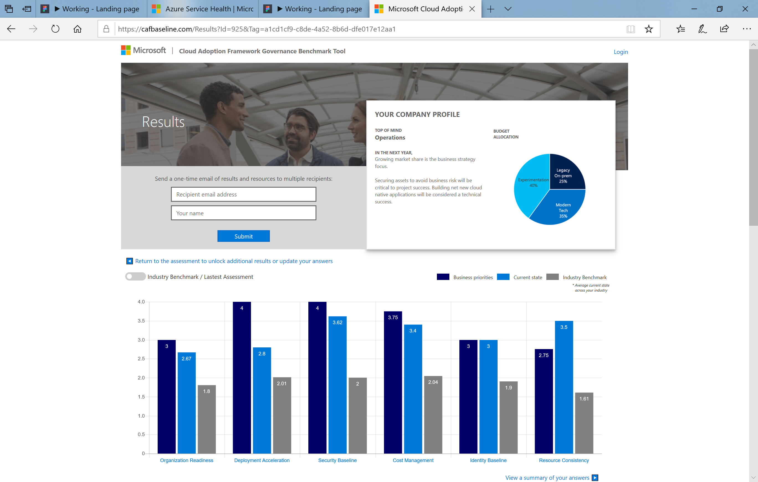
Benchmark Your Governance State
Make governance actionable with processes and policies. Use the Governance benchmark tool.
Establish a governance baseline and recommended starting-point
Understand gaps between your desired and current governance state, using the Cloud Adoption Framework.
Remove blockers with curated guidance on how to build a proper Governance foundation.
https://cafbaseline.com/

Slide 31
Benchmark Assessment Results

Slide 32
Take action and set up your initial governance foundation

Slide 33
Drive cloud adoption efficiency in an iterative governance process – four key exercises to focus on:
Methodology overview
Establish a basic understanding of cloud governance
1
Governance benchmark
Assess your current state and the future state to get started
2
Initial governance foundation
Begin establishing your governance foundation by implementing a set of governance tools
Initial governance foundation
Begin establishing your governance foundation by implementing a set of governance tools
3
3
Evolve governance foundation Iteratively add governance controls to address risks
4

Slide 34
Executing Incremental Governance
Governance MVP
Establish a foundation that can quickly evolve as cloud adoption and cloud governance mature. Mitigate tangible risks identified in the cloud adoption plan.
Governance MVP
Identity strategy
Security management discipline evolves
Resource management discipline evolves
Cost management discipline evolves
Network & encryption strategy
Update corporate policy… Implement with configuration management changes
Update corporate policy… Implement with configuration management changes
Update corporate policy… Implement with configuration management changes
Risk Evolutions
The risk profile will change as you plan additional iterations of cloud adoption. The cloud governance team monitors those adoption plans to identify risks and evolve corporate policy statements.
Configuration strategy & corporate policy implementation
Risk:
Protected Data
Risk:
Critical Apps
Risk:
Cost
Cloud Adoption Adoption timeline will trigger risks along the journey

Slide 35
Build the Governance MVP
Standard Enterprise |  | Complex Enterprise
Customers or staff reside largely in one geography |  | Customers or staff reside in multiple geographies or require sovereign clouds
Business units share a common IT infrastructure |  | Customers or staff reside in multiple geographies or require sovereign clouds
Single IT budget |  | Budget allocated across business units and currencies
Capital expense-driven investments are planned yearly and usually cover only basic maintenance |  | Capital expense-driven investments are planned yearly; often include maintenance and refresh cycles of 3-5 years
Datacenter or third-party hosting providers with fewer than five datacenters |  | Datacenter or third-party hosting providers with more than five datacenters
Networking includes no WAN; or 1-2 WAN providers |  | Networking includes complex network or global WAN
Identity is a single forest, single domain |  | Identity consists of multiple forests, multiple domains
Cost Management (cloud accounting) showback model – billing is centralized through IT |  | Cost Management (cloud accounting) chargeback model – billing can be distributed through IT procurement
Security Baseline – protected data: company financial data and IP. Limited customer data. No third-party compliance requirements. |  | Security Baseline (protected data) – Multiple collections of customers' financial and personal data

Slide 36
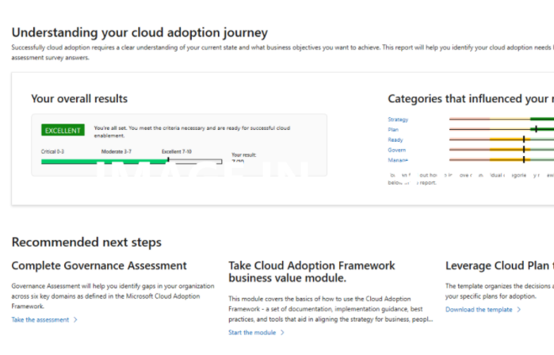
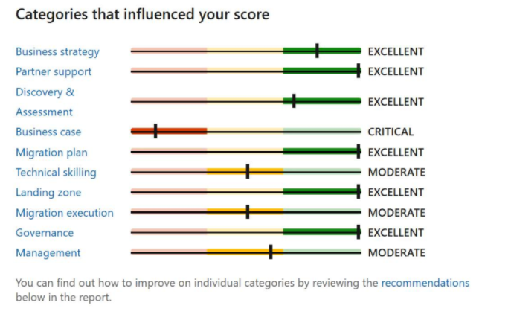
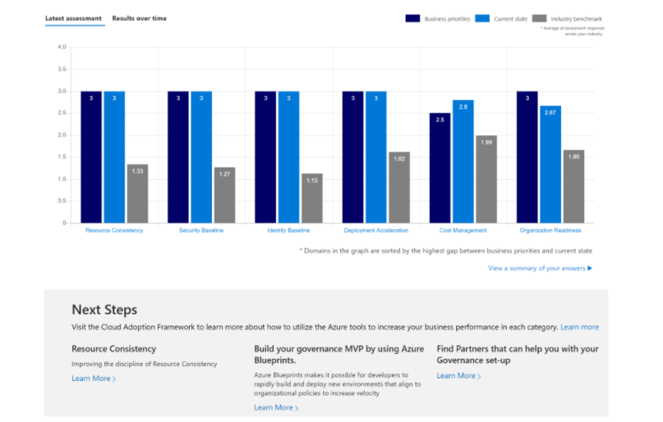
Evaluate Your Cloud Readiness using Microsoft Assessments
Strategic Migration Assessment & Readiness Tool
Cloud Journey Tracker
Governance Benchmark
Identify your cloud adoption needs and find recommendations for your unique cloud journey.
Understand your organization’s preparedness to implement a cloud migration at scale.
Identify gaps in your organization’s current state of governance and get curated guidance on how to get started.

Slide 37
How Can Veraqor Help?
Briefing
Assessment
Proof of
Concept
Implementation
Understand the Importance and key benefits of Azure Governance & Compliance
Governance Architecture will be shared after assessment of subscription.
POC provides a test bed where we can migrate your workloads and applications to a cloud environment
Governance Architecture Subscription will be migrated to governance architecture.
Briefly discuss about Implementation Of Azure Governance and Its Disciplines including Cost Management, Security Baseline, Resource Consistency, Identity Baseline, Deployment Acceleration
Assessment Report will be shared on 5 key areas of Microsoft Azure Governance
Azure high level design, Analysis and Planning report, Pre-Engagement Questionnaire
Documentation around the governance mapping, architecture, and migration roadmap.
Training and Best Practice regarding Azure Governance tools
Migration Plan will be shared including ARM template and onboarding through Azure lighthouse
It makes your business more efficient and saves time and money
Training and best practices regarding Azure Governance tools
Duration: 2 Hours
Investment: FREE
Duration: 3 Weeks
Investment: $10,000
Duration: 3 Weeks
Investment: $6,000
Duration: 6 Weeks
Investment: $25,000

Slide 38
Thank you!
Please spare a moment to fill out the survey after this webinar.
Need help? Please write to:
mtu@veraqor.io

